Slide 1
How to fundraise as a club
Club Development Day

Slide 2
What is the purpose of fundraising?
Clubs choose to do fundraisers because they have specific goals:
Club field trips
Club purchases
Club events
Fundraisers provide an opportunity for clubs to work together toward a common goal.

Slide 3
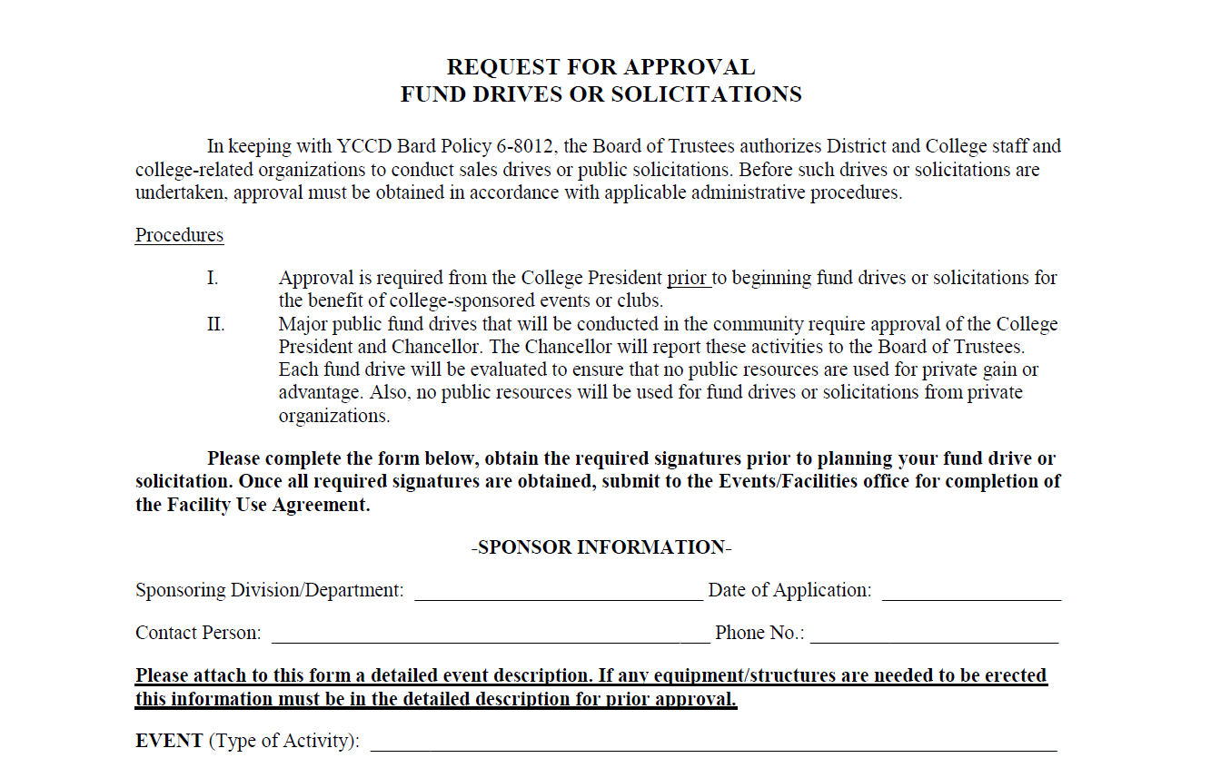
The fund drive form
Whether you have a fundraiser on or off campus as a club, a fund drive form must be completed.
For clubs, the sponsoring division/department is CL&SL.
The contact person is the club member who is completing the form.
You may list the entire semester’s planned fundraisers on this form (attach a list, if necessary).

Slide 4
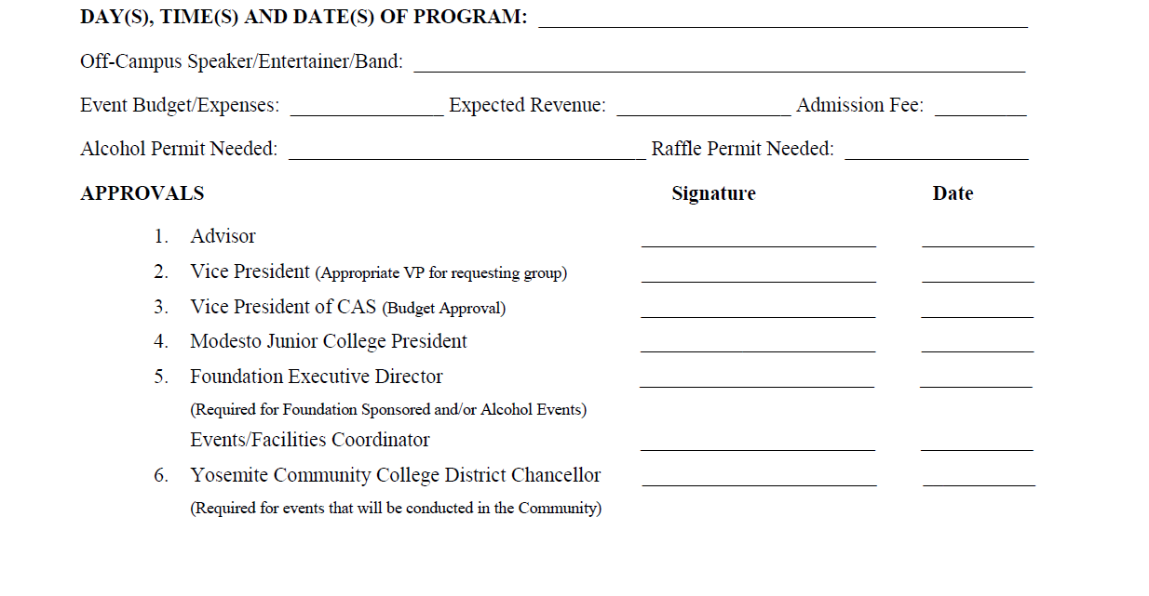
The fund drive form cont’d…
We recommend putting “Semester and Year” for the day, time, date field (ie: Fall 2016 or Spring 2017)
Clubs are responsible for obtaining the advisor’s signature (line 1).
Signature lines 2-4 are obtained by CL&SL and Facilities. The forms circulate through the VPSS office, VPCAS office, and the President’s office.

Slide 5
Fund drive form: sequence of events
Meeting takes place where you approve the fundraiser(s).
Fund drive form is completed and submitted.
Facilities receives completed fund drive form and all listed club fundraisers are on file.
WHEN?
Beginning of the semester
Four weeks prior to first fundraiser
Two-three weeks prior to fundraiser

Slide 6
Common types of fundraisers throughout Mjc history
food prep and sales
on campus sales
fund-raisers for 3rd parties
off campus fundraiser
flyers
take home sales
drives
donations

Slide 7
Things to consider when planning a fundraiser
What types of things do students want to spend money on?
What is your profit margin?
How many club members are able to participate?
During what time of year are you planning to fundraise?
Is there something you can capitalize on?
Are there certain times that certain fundraisers won’t fare as well and vice versa?

Slide 8
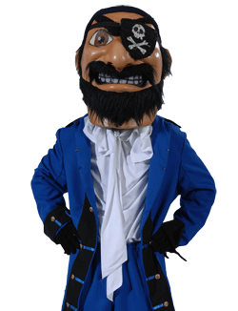
Suggestions for fundraisers

Slide 9
High yielding fundraisers
Take home sales
Pies cost $7.50 / Club can charge any amount
Flyers / Take home sales
25% from flyer sales / 70% from take home sales go to the club
Flyers
20% of sales go to the club

Slide 10
High yielding fundraisers
Flyer
50% of sales go to club
Take home sales
Up to 50% of sales go to club
Take home sales / On campus sales
50% of sales go to club

Slide 11
High yielding fundraisers
Take home sales / On campus sales
On average, 50-60% of sales go to the club
Flyer
20% of sales go to the club
Flyer
15% of sales go to the club

Slide 12
Please join us for our next club development day workshop
“Planning For Next Semester”
Thursday, November 17th
2:30-3:30pm
CAT 208

