Slide 1
Paving the Path
Aligning with Transfer Institutions

Slide 2

Building Coursework Roadmaps:
Data Collection First
Competencies
Transfer Institutions
Careers

Slide 3
General Education Classes
ILO, GELO, & PLO
Submit Program Materials and Sequence of Program Map
Build a Sequence

Slide 4
Careers
  Specify what career options a student can obtain with a Certificate, Associate, and a Transfer degree in your Program?
  Give a range of income for each of the degree options ie Certificates, Associates or Bachelors .
  Do the degrees we offer provide a sustainable income of a living wage? If not, how can we offer scaffolding degrees?
Competencies

Slide 5
Competencies
  Provide the competencies and skills students are learning in your classes (program) that directly link to the skills and competencies that employers are wanting their employees to have.
  We must find out who your typical employers are in this industry and what are they looking for to help answer the above question.
Transfer Institutions

Slide 6
Transfer Institutions
  Do your courses transfer and articulate with the most common transfer institution within your program?
  What lower division courses are offered at your program’s most likely transfer institutions, particularly at our CSU and UC partners?
  Do you program learning outcomes align?
  For CTE programs, have you considered a transfer major a student could pursue and are those classes part of your program at MJC?

Slide 7
General Education Classes
  Once you have looked at your classes within your major, are there areas from your overall competencies list where you can see a specific GE class would benefit the student with their overall degree and career competencies and skills.
  Example : An employer may want an employee to have good oral communication skills. Does your program’s classes have those skills incorporated in them? If not, then you could consider the GE class of Comm 100: Introduction to Public Speaking to help support the student’s knowledge and applicable skills.
  You will also want to consider your transfer institutions requirements for the major. Your faculty counselor colleague can assist you with finding this information.

Slide 8
  Do your courses and program map align with our:
  - Institutional Learning Outcomes,
    Communication, Information & Technology Literacy,
    Personal & Professional Development,
    Creative, Critical and Analytical Thinking,
    Cultural Literacy and Social Responsibility
    - General Education Learning Outcomes
    Natural Science
    Social and Behavioral Science
    Humanities
    Language and Rationality
    Health Education
    - Program Learning Outcomes?
    Each program has their own outcomes.
ILO, GELO,PLO

Slide 9
Build a Sequence
  Now that you have all of the information, develop a program map of courses in a sequence of order to allow the student to build on skills and competencies while keeping in mind the sequence of classes that align with your transfer institutions.
  The student should have a seamless transition to their career or transfer institution.

Slide 10
What are the Blue and Green Patterns?
What is IGETC?
Are students able to transfer without completion of GE?
What are the Golden Four?
What is IGETC for STEM?
Did you Know 2 out of every 3 Community College Students who apply to the UC are admitted?
Why are CC students the first priority for transfer to a UC?

Slide 11
Transfer pathways
Transfer Pathways: Your roadmap to 21 top majors
If you're starting out at a California community college and know which major you want to study but haven't decided which UC campuses to apply to, there is a simple way to keep your options open as you prepare for your major.
Follow one of our new Transfer Pathways, a single set of courses you can take to prepare for your major on any of our nine undergraduate campuses.
The Transfer Pathways cover 21 of our most popular majors:
Anthropology
Biochemistry
Biology
Business administration
Cell biology
Chemistry
Communication
Computer science
Economics
Electrical engineering
English
Film and media studies
History
Mathematics
Mechanical engineering
Molecular biology
Philosophy
Physics
Political science
Psychology
Sociology

Slide 12
TAG
ADT’s
Local Area Residency for the CSU
What is WOW?

Slide 13
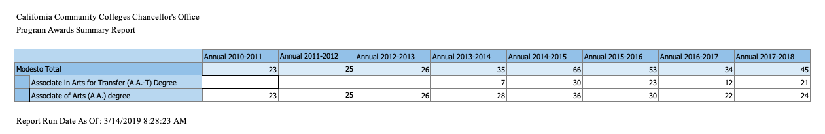
Coursework within the Major
TMCs, ADTs, C-IDs and Understanding our Transfer Partners

Slide 14
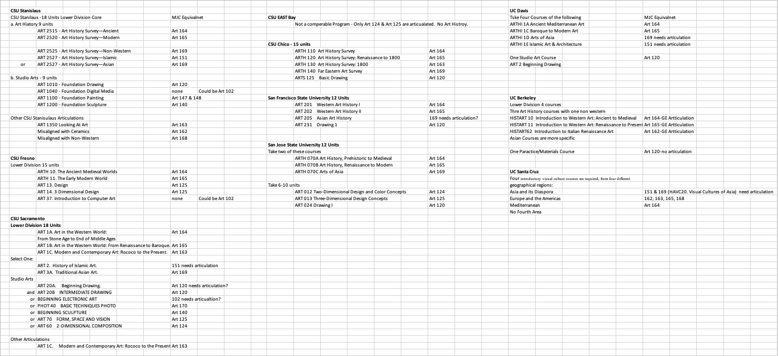
Art History Lower Division Patterns at all Northern California CSUs & UCs

Slide 15
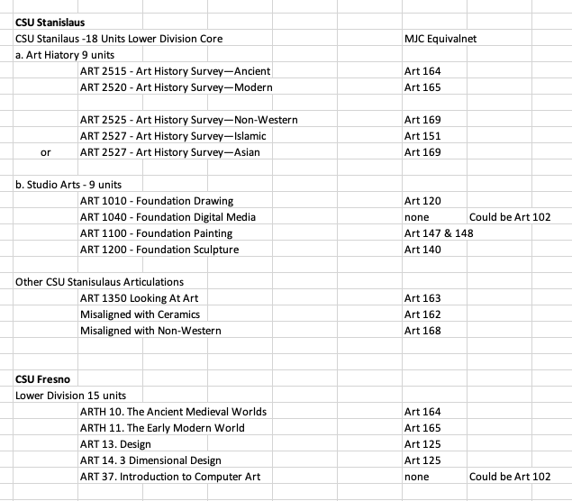
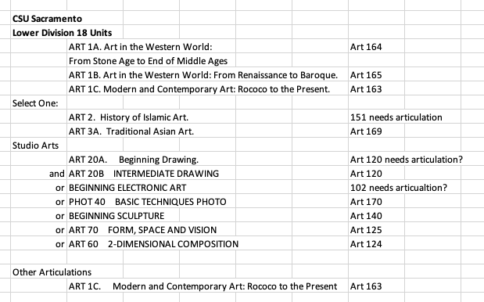
Where is Art 162: History of Renaissance Art at local CSUs

Slide 16
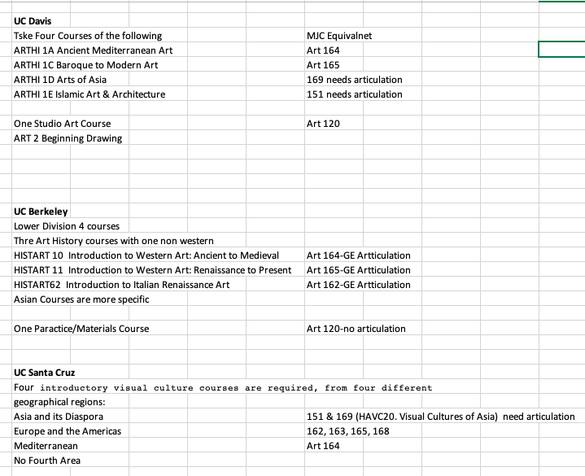
Where is Art 162: History of Renaissance Art at local UCs

Slide 17
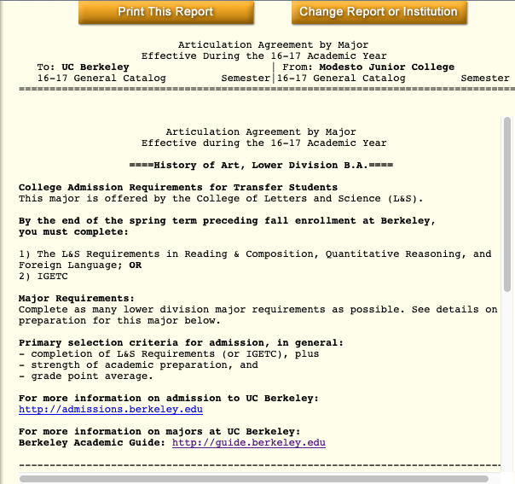
Where is Art 162: History of Renaissance Art at UC Berkeley

Slide 18
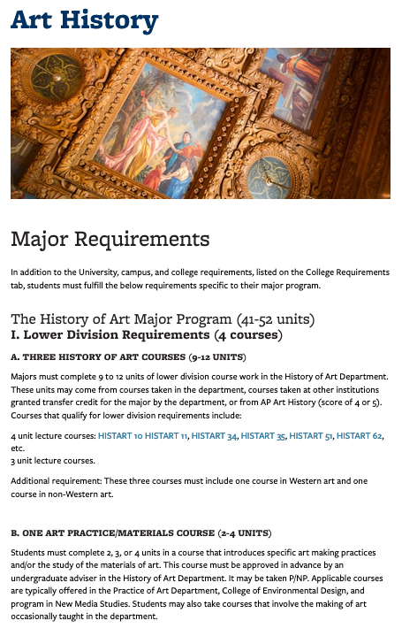
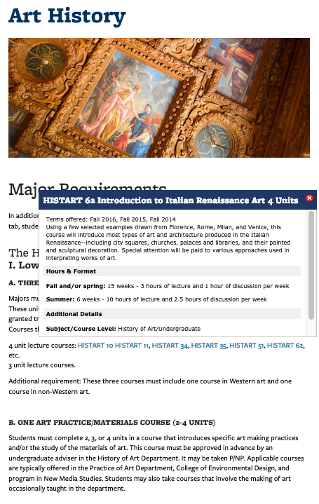
Where is Art 162: History of Renaissance Art at UC Berkeley

Slide 19
Our students don’t have access to this document.
If these resources were confusing just image how a student would feel.
Who is better qualified to explore the lower-division programs of our transfer institutions and align with them than the faculty who are the discipline experts?

Slide 20
Articulation
The process and product through which courses and programs are formally recognized as comparable to educational experiences offered within another institution or system.

Slide 21




HIGHER EDUCATION iN CALIFORNIA
WHERE WE FIT
Independent
Colleges &
Universities

Slide 22
Articulation
DETERMINES WHICH MJC COURSES
transfer as general elective credit for admission to/graduation from CSU and UC
can be used as elective lower division credit in the major
satisfy various General Education breadth requirements
can be identified as a given C-ID
can be used in an Associate Degree for Transfer (AS-T, AA-T)
can be articulated course-to-course at one or more CSUs/UCs
can be articulated as lower-division major preparation for upper-division coursework

Slide 23

Articulation
OFFICERS
IN THE CENTER
Providing support to colleagues in the development of qualifying curriculum
Educating faculty on the impacts of curricular design in various transfer contexts
Sole faculty member focused on transfer elegance in the college curriculum
Liaising between institutions and higher education “segments”
  CCC, CSU, UC, Private/Independent Colleges
Reviewing curriculum proposals to ensure they meet criteria
Advocating and collaborating within the statewide articulation council
(CIAC) on issues that impede or confuse pathways for students

Slide 24

Articulation
CAN’T FUNCTION WITHOUT

