Slide 1
Carl D. Perkins Act In-Service May 7th & May 13th, 2020 Presented by:
Pedro Mendez, Dean of CTE, Community & Workforce Development Don Borges, Dean of Agriculture & Environmental Sciences Manny Walsh, Administrative Secretary

Slide 2
Carl D. Perkins Act In-Service
Session Goals: Attendees will be able to
Describe the intent of the Carl D. Perkins Act
Describe the MJC Carl D. Perkins college process
Complete the 2020-21 Carl D. Perkins Act Application

Slide 3
Carl D. Perkins Act 2020-21FY
The 2020-21 FY Based on:
10,110 "unduplicated head count of economically disadvantaged students" identified as CTE students in YCCD (Modesto Junior College and Columbia College).
Numbers pulled from our 2018-19 Cohort Numbers.
MJC represents an estimated 89% of that amount (8,984)

Slide 4
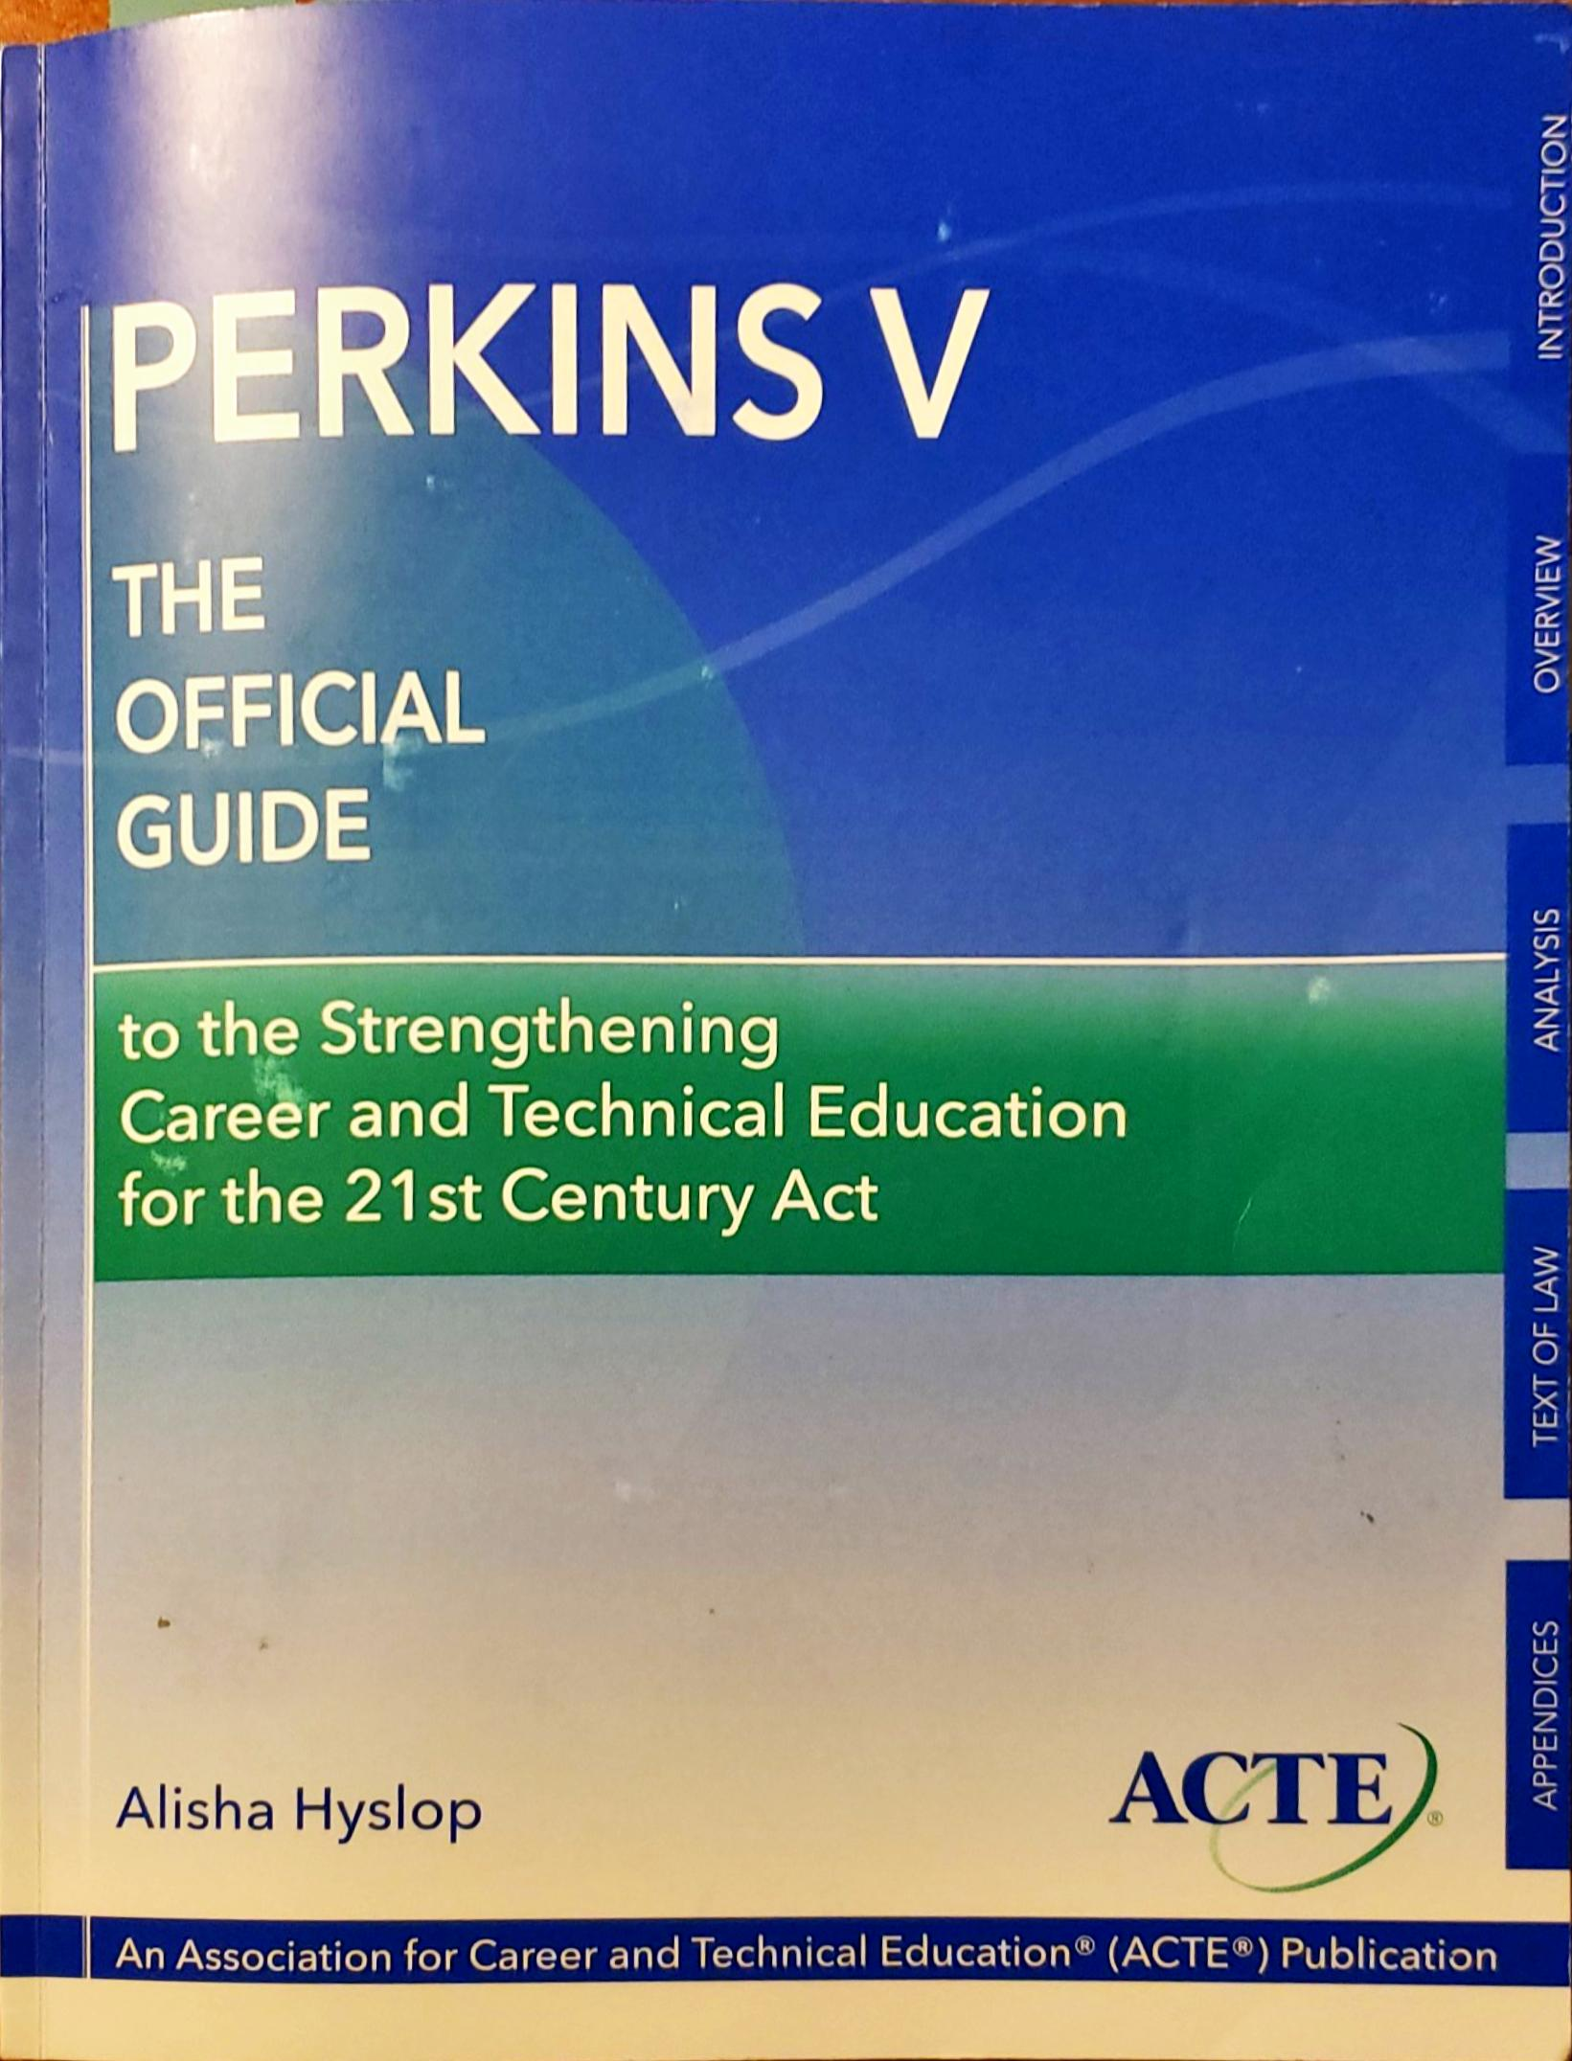
Background
Perkins V: The Strengthening CTE for the 21st Century Act became law and was number Public Law 115-224.
The Federal Process began in 2012 and was signed by President Trump in July 2018.

Slide 5
Purpose of Perkins V
Develop challenging academic and technical standards and integrated instruction
Link Secondary Education and Post Secondary Education
Develop, implement and improve CTE
Conduct and disseminate national research and best practices
Provide technical assistance & professional development
Promote partnerships among secondary, post-secondary and baccalaureate granting schools, workforce investment boards and business & industry
Knowledge and skills to keep America competitive
Increase employment opportunities for

Slide 6
Basic Criteria for Funds
Expenditures Must:
Meet the purpose of the Act
Be for a Program Areas identified in the Community Needs Assessment
Expenditures May Not be Used for:
General purposes
Maintenance of existing programs

Slide 7
What Types of Budget Items can Generally be Considered Eligible?
OBJECT CODE 1000: Stipends
OBJECT CODE 2000: Classified Hourly (no permanent)
OBJECT CODE 4000: Instructional Materials
OBJECT CODE 5000: Fees, Local Travel, Field Trips, Outreach
OBJECT CODE 6000: Instructional Equipment

Slide 8
Types of Costs are NOT Eligible
1. Student expenses or direct assistance to students *
2. Entertainment
3. Awards and memorabilia
4. Individual memberships
5. Membership with orgs. that lobby
6. College tuition, fees, books
7. Fines and penalties
8. Insurance/self-insurance
9. Expenses that supplant
10. Audits, except single audit
11. Contributions and donations
12. Contingencies
13. Facilities and furniture *
14. General advertising
15. Alcohol
16. Fund raising
17. General administration
*See Notes Page for clarification
Notes:
Student Expenses
In providing support for a program for individuals who are members of special populations, districts may use Perkins funds to provide direct assistance to students if all of the following conditions are met:
Recipients of the assistance must be individuals who are members of special populations who are participating in vocational and technical education programs.
Assistance may only be provided to the extent that is needed to address barriers to the individual’s successful participation in vocational and technical education programs.
Direct financial assistance must be part of a broader, more generally focused effort to address the needs of individuals.
Funds must be used to supplement, not supplant.
Facilities and Furniture
1. EDGAR
Provisions in the Education Department General Administrative Regulations Part 76 subpart F Sec. 76.533 Acquisition of real property; construction.
No State or subgrantee may use its grant or subgrant for acquisition of real property or for construction unless specifically permitted by the authorizing statute or implementing regulations for the program.
Perkins is silent on facilities. The interpretation of the Chancellor’s Office is that construction is not an allowable expenditure.
EDGAR Part 74c Section 74.27 refers us to OMB circular A21 which specifies in J.16(B)(1) and (3)
(1) Capital expenditures for general purpose equipment, buildings, and land are unallowable as direct charges, except where approved in advance by the sponsoring agency.
(2) Capital expenditures for improvements to land, buildings, or equipment which materially increase their value or useful life are unallowable as direct charges, except where approved in advance by the sponsoring agency.
Sponsoring agency as used in the OMB circular is the USDE
2. Supplanting
The prohibition against facilities and furniture can also be based on the Supplement/Not Supplant provision found in Section 311 of the Perkins Act. Generally construction of a facility is a local responsibility as is the furnishing of the facility with furniture etc. Therefore, to charge such costs to the Perkins grant would be a supplanting of a local responsibility.

Slide 9
What are the Six Requirements for Uses of Perkins V?
Provide career exploration and career development activities through an organized, systemic framework designed to aid students before enrolling and while participating in a CTE program, in making informed decisions about future education, career education and programs of study, which may include:
Introductory courses or activities focused on career exploration and career awareness
Career and Labor Market Information on occupational supply and demand, education requirements, employment sectors, etc.
Activities related to student graduation and career plans
Career guidance and academic counseling on postsecondary education and career options
Activities that assist students to make informed decisions about education and employment goals
Understanding of an Industry

Slide 10
What are the Six Requirements for Uses of Perkins V?
Provide professional development for teachers, faculty, school leaders, administrators, specialized instructional support personnel, career guidance and academic counselors or paraprofessionals, which may include
Integration of academic and CTE standards and curricula
Labor Market Information
Advance knowledge, skills and understanding of an industry, latest workplace equipment, technologies, standards and credentials
Strategies to improve student achievement
Evidence based pedagogical practices
DSPS
Frameworks to effectively teach students (i.e. universal design teaching, multi-tier systems supports, positive behavioral intervention, etc)
Effective use of community spaces (i.e. makerspaces)

Slide 11
What are the Six Requirements for Uses of Perkins V?
Provide programs with the skills necessary to pursue careers in high-skill, high-wage or in-demand industry sectors or occupations
Support Integration of academic skills into CTE Programs and Programs of Study to support CTE participants at the postsecondary level in achieving academic skills.

Slide 12
What are the Requirements for Uses of Perkins V?
Plan and carry out elements that support the implementation of “CTE Programs” and “Programs of Study” and result in increase student achievement
Curriculum aligned with Program of Studies
Sustainable relationships with education, industry and community stakeholders
Articulations and dual enrollment
Equipment, technology and instructional materials aligned with business and industry
Work-based learning opportunities
Industry-recognized certifications leading to a post secondary credential

Slide 13
What are the Requirements for Uses of Perkins V?
Plan and carry out elements that support the implementation of “CTE Programs” and “Programs of Study” and result in increase student achievement [Continued]
CTE Program Faculty and Staffing Outreach & Hiring Strategies
Coordination with Workforce Development Programs and other Initiatives
Distance Education
Competency-based education programs
Integration of employability skills into CTE Programs
Increase access and student engagement for student of underrepresented groups in STEM fields
CTE student leadership and technical skills competition
Open Education Resources

Slide 14
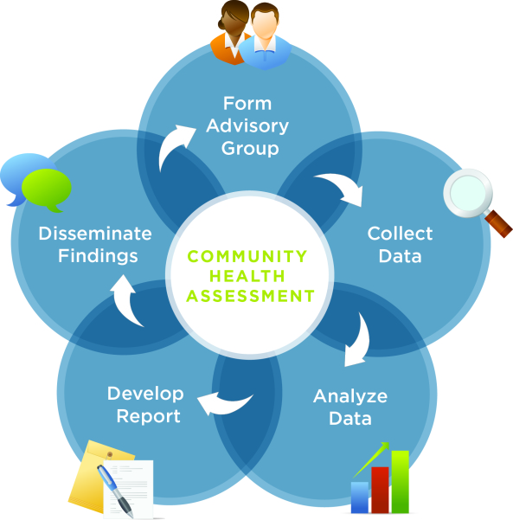
What are the Six Requirements for Uses of Perkins V?
Development and implement evaluations of activities carried out with funding including the Community Needs Assessment

Slide 15
Supplement, Not Supplant !!
Cannot use Federal Funds to pay for Services, Staff, Programs, or Materials that would otherwise be paid with State or Local Funds

Slide 16
What Do Auditors Look For? *
Expenditures are budgeted
Obligations occur in work plan academic year
Funds supplement and not supplant
4. Expenditures are documented & allowable
5. Procurement methods provide free & open competition & prevent conflict of interest
6. Compliance issues
a. Program offerings
b. Student participation
c. Assessment
7. Time distribution records
* See Notes Page for clarification.
Notes:
Item 1: All incurred expenditures relating to the program must have supportive documents to justify the costs. The intent is to verify that the expenditures meet the needs of the students and the program.
Item 2: In reviewing for compliance issues for the three topics, the intent is to verify that the program, students, and the assessment has been designed to benefit the students who are vocational, by documenting the support services received.
Item 3: Inquires will be made as to whether or not any of the salaries or expenses from federal funds replaced state and/or local funds.
Item 4: Inquiries will be made to identify whether or not any of the employee’s salary are being paid from two or more different funding sources. If they are, then a time distribution report must be maintained.
Item 7: Verify that a physical inventory has been performed every two years as required by OMB A-110.
Item 9: Review the budget for any changes and verify that any change has been approved.

Slide 17
Equipment Purchase & Inventory?
Equipment is defined as having a purchase price of $200 or more and a useful life of one year or longer
Equipment shall be maintained in a trace inventory system if the equipment is worth $5,000 or more and a useful life of one year or longer – YCCD Tags and Division Inventory Listing
Equipment shall be identified as having been purchased with Perkins funds

Slide 18
MJC Perkins V College Process
Applications must be submitted by application due date.
Only Applications that are complete and meet all requirements will be considered
Applications are scored by an application review committee
Funded applications are determined based resources available for that year in ranking order
Announcement of funded application will be made in June 2020.

Slide 19
Perkins V Application
CCCCO Process - Annual application
Provide specific program improvements and how improvement activities meet state/local-adjusted performance levels established for core indicators
Provide at least one CTE Program of Study
Application Time Line
Due Thursday, May 28th
Due June 10th District Grants Office
Due June 15th Sacramento

Slide 20
MJC Team:
Manny Walsh: 575-6452
walshm@mjc.edu
Deans:
Don Borges, 575-6198
borgesd@mjc.edu
Pedro Mendez, 575-6355
mendezp@mjc.edu
VP of Instruction:
Dr. Jennifer Zellet, 575-6058
hamiltonj@mjc.edu

