Slide 1
CAP Conference and Transition Workshops
Spring 2017 SSEC Grant Report-Out

Slide 2
Agenda
Background to CAP/SSEC Proposal
Major Take-Aways
Differences in Acceleration between English and EL
Future Steps Brief
Report-Out on EL Transition Workshops
Questions?

Slide 3
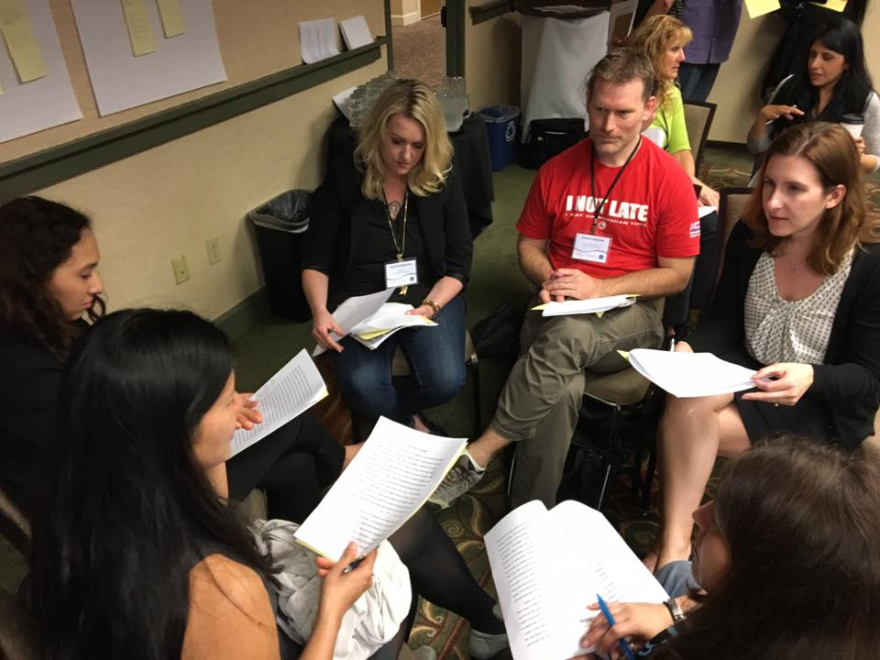
Background
SSEC Proposal
Pre- and Main Conference Attendance
Launchpad Continuing Conversations and Study
CAP Conference
- Pre-Conference
- Workshops
- Plenary Sessions

Slide 4
Snapshot of Workshops
A Sample of Workshops, Institutes, and Plenaries
“What is Good Enough English?”
“Acceleration in ESL: Accelerated Pedagogy in ESL”
“Designing Successful Pathways for ESL Students”
“Acceleration in ESL: Highpoints and Headaches”
“Supercharging Accelerated English Classes”
“Working Toward a Growth Mindset in Grading”
“ESL Accelerated Pedagogy in Practice”
“Basic Skills and the Legislative Landscape”

Slide 5
MAJOR Takeaways
ACHIEVEMENT
MJC’s English Language Department is Fully Engaged
Integrating Reading with Writing
Themes Focus on the Human Experience & American Culture
Selected Vocabulary Development
Academic Literacy in Use
Just-in-Time Language Instruction

Slide 6
MAJOR Takeaways
POSSIBILITIES
Articulated Curriculum Design
Build a library of Interconnected Course Materials
Themes, Texts & Supporting Articles
Vocabulary Development Practice
Critical Thinking Strategies
Evaluate and Modify
Continue Alignment with English Curriculum
Monitor Exit Points

Slide 7
Differences & Similarities: English and EL
need for more time, practice, and skills development
need for more vocabulary development
need for explicit instruction in the language
need for building schema on American culture & history
need for highly scaffolded materials
functionally fluent in the language
culturally familiar with a number of topics discussed in CC classrooms
implicit understanding of rhetorical organization
great deal of implicit vocabulary knowledge
need for building multi-cultural schema
aspirations/goals
ability to think critically
both belong at the college

Slide 8
Future Steps
Work Ahead
May 3rd-4th Training at MJC (FT EL Department participation)
Materials Revision/Development
Reading/Writing Survey
Further Study/Department Discussions
Need for Further Discussion
Grading Norms and Variance across Disciplines
Fall 2017 CATESOL Presentation Brewing:
“Combining Critical Thinking, Acceleration, and Civic Engagement”

Slide 9
SSEC Grant: EL Transition Workshops 30-40 in attendance

Slide 10
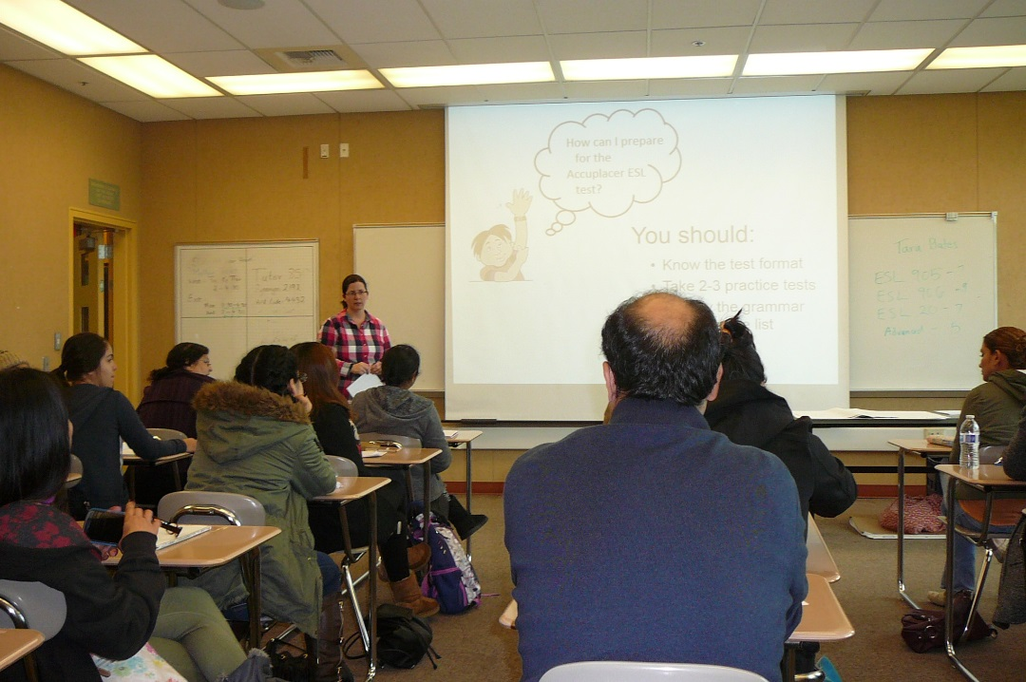
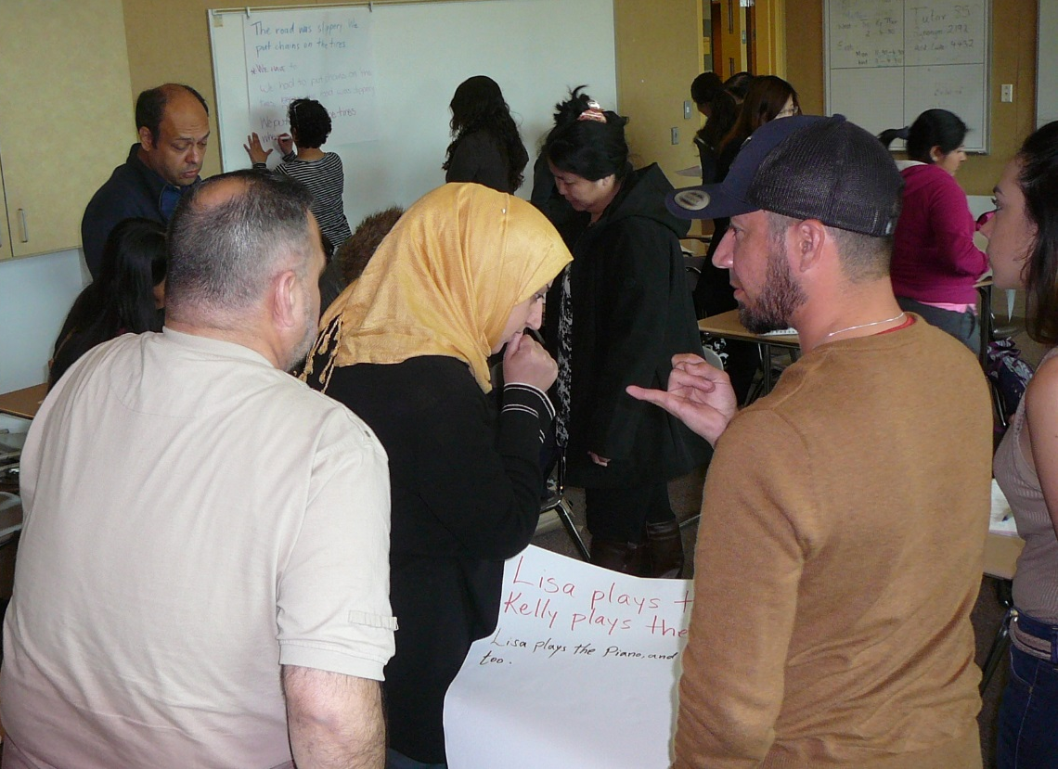
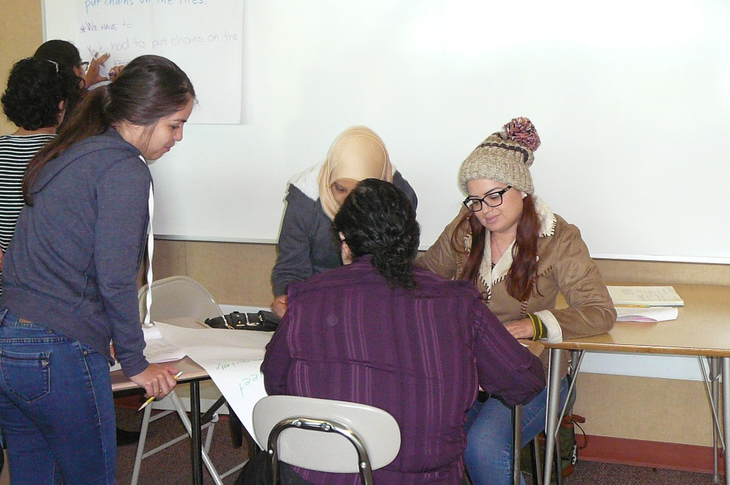
Transition Workshops

Slide 11
SSEC Grant: EL Transition Workshops- Data Collection

Slide 12
Preliminary Data: One Workshop
100%
97%
3%
100%
94%
6%
94%
6%
97%
3%

Slide 13
Workshop Comment Data: Best Part?
She explain really carity
All very good presentation
grammar + reading + how to make profissional email
emailing explanation
Every single page
I learn about reading
everything was great
present prefect
It's grammar part.
The examples were clear
all points
writing tips
Present prefect
The all presentation was very good
everything is very useful
The professor will explain very well
The auxiliry have
It help me understand more and I looking come next shop
Gramar: Present Perfect tence
grammar: present perfect tense
The teacher was excelent
yes
everything is useful of this presentation
about the topic how to write topic
Everything
Presentation teach Mrs Kate about Perfect tense
Explaining how to read

Slide 14
Comment Data: Make Better?
more hours
everything was great
NA
We need more time
It helps me if the time is more
the time is very short
It can spend more time
vocabulary, definitions, synonym, antonyms
improve my grammar, writing and reading skills
talk more slouly
more hour for practice
No, it was perfet/could you give more exercises to practices and the other workshops
It is next time, I will have a better to understand the explanation
more time definitely/I think is better 3 hours
I would like to have more time in class
more time lo learn more
More hours for practice
I understood better/I really feel happy with this short classes
she has excellent knowledged/\could she make other workshop for us
maybe we need a more time
I think we need more days and more time
writing/more time
More important and increase my knowlege
add more hour

Slide 15
Future Topics?
more writing and grammar workshops
I wish to continue by doing this workshops for a new student each semester
wil-did auxiliary
more ideas
Gerund
Gerund and Infinitives
More reading and writing and grammar
all of them
a specific topic like how to make an outline
resume letter
writing
Those topics that useful for students of ESL
any topics could help us well
More examples
Present perfect Tense
Tenses
Auxiliary will
Essay writing
more informations about grammar
I would like to see more grammar in the future.
reading
more practice/use fun games for learn.only one subject because the time is limited
more convertion
could you please make one of commas

