Slide 1
Modesto Junior College
Achieving the Dream Data Summit
September 11, 2015

Slide 2
Our students.
Our responsibility. Our commitment.

Slide 3
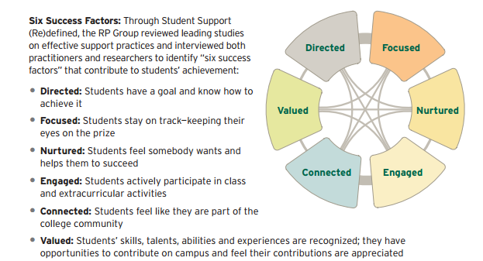
Where we’ve been…

Slide 4
Where we’ve been…
Darla Cooper’s Student Support (Re)Defined
SSSP
Student Equity
Basic Skills Initiative
Great Teacher’s Retreat
Acceleration
Growth Mindset
Reading Across the Curriculum
Understanding Cohort Migration Data
Understanding our students and engaging Equity

Slide 5
What’s on the horizon…
Professional Development opportunities for staff
Professional Development opportunities for part-time
October 16: Multi-college conference
Setting the Stage: Regional Approaches to Success and Equity in the Central Valley
Jennifer Coleman, Statewide Program Director for the Common Assessment Initiative
Craig Hayward, RP Group: Multiple Measures Assessment
3CSN Program Overview: Data-Informed Practices for Success
Lunch
Afternoon Workshops
California Acceleration Project (CAP)
English Acceleration
Math – Path2Stats
Habits of Mind
Reading Apprenticeship

Slide 6
Bringing the Big Projects Together: Basic Skills, SSSP & Equity
The four components
Gonzalez, 2009; 2014
Comp 1
Comp 2
comp 3
comp 4
Review BS, SSSP &
Equity Outcome Data
Identify Underlying
Factors
Design/Revise/Expand
Interventions
Evaluate/Modify/Scale
Using longitudinal,
disaggregated, cohort
data, assess student
success and equity
outcomes (e.g., Basic Skills Completion, Persistence,
Course Completion rates,
Degree/Cert. comp. rates, etc.) to determine:
1) Which student
groups are less successful than others.
(Equity Gaps).
2) Which high enrollment courses have the lowest success rates.
Collect, analyze, and use evaluation data to answer:
To what extent did the interventions (or policy changes) effectively address the underlying factors impeding student success & equity?
To what extent did the interventions increase student success equity?
Make modifications based on evaluation results.
Scale-up, if promising.
Collect, analyze, and use SECOND set of LOCAL data to identify the underlying factors (barriers or challenges) impeding student success & equity:
DATA SOURCES:
• Focus groups
• Surveys
• National/State
Data/Literature
• Learning Outcome
Assessment
Using data from
COMP 2, revise, design, or expand interventions to effectively address the underlying factors impeding student success.
Review and consider changes to existing college policies that impact the underlying factors impeding student success.

Slide 7
Let’s Meet Our Students
Fall 2015 Enrollment Data: Ethnicity

Slide 8
Student Testimonial
First Time In College
Criminal Justice Major
AA Male
Are We Ready For Our Students?

Slide 10
Student Testimonial
Returning Student Hispanic Male 9 Units Completed
Are We Ready For Our Students?

Slide 11
Student Testimonial
Hispanic Female Transferring Spring
Are We Ready For Our Students?

Slide 12
Student Testimonial
Hispanic Males & Females
Are We Ready For Our Students?

Slide 13
Text the following message to this number:
Phone number: 22333
Message: JAMESTODD542
one word, no spaces
You should receive a message that says you’ve joined session JAMESTODD542
Once you’ve joined, wait for the question and text your choice of A, B, C, D or E (enter only the letter and send)
You can text only one answer per question

Slide 14
Basic Skills Placement and Success Rates
Were these the placement rates you expected? What is the impact of placement in student success?
How equitable are our placement practices? How do you think we are meeting the needs of our students?
What does this data mean for you?
Are We Ready For Our Students?

Slide 15
Placement to College Level Success
Were these the success rates you expected? What do you think might contribute to these success rates?
Do you think we might have barriers to student success? If so, what are they?
What does this data mean for you?
Are We Ready For Our Students?

Slide 16
First Term Grade Point Average
Were these the GPA rates you expected? What do you think might contribute to these GPA rates?
What can we do as an institution to help First Time in College students succeed beyond the first semester?
What does this data mean for you?
Are We Ready For Our Students?

Slide 17
Persistence and High-Demand Course Success
Is the overall Fall-to-Fall persistence rate acceptable? Why or why not?
Is there a relationship between attempted units and persistence?
Which groups are experiencing greater persistence gaps and rant these in order of most critical need?
How ready are we in every class and program to meet the needs of our diverse student population?
Are We Ready For Our Students?

Slide 18
GPA After First Semester
50%
51%
40%
39%
10%
10%

Slide 19
Success rates in top 15 high-demand courses, Fall 2014

Slide 20
Our students.
Our responsibility. Our commitment.

Slide 21
Modesto Junior College
Achieving the Dream Data Summit
September 11, 2015

