Slide 1
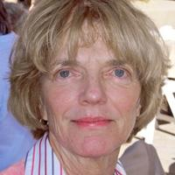
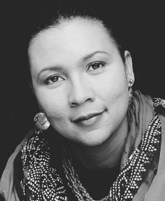
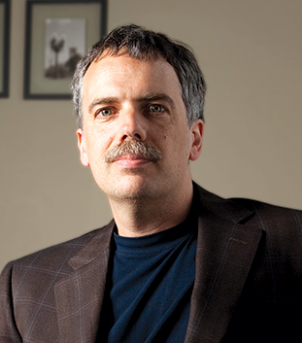
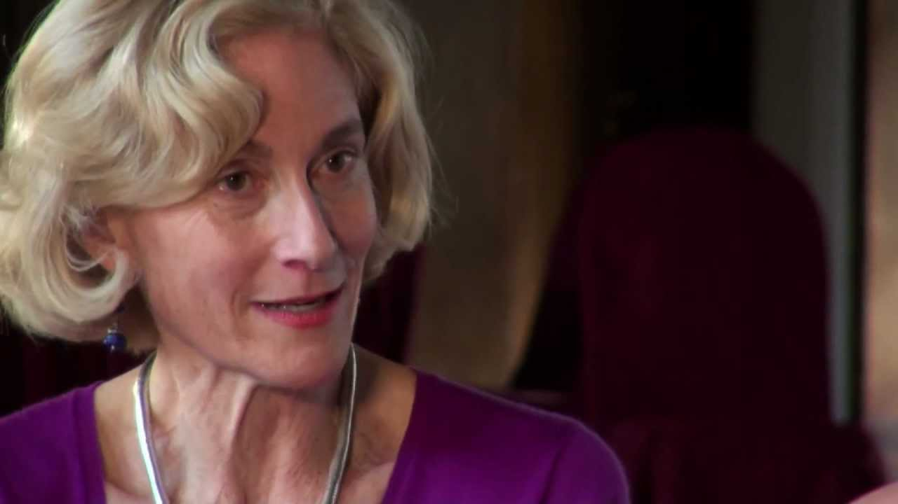
Philosophy Restorative-Growth Positions
BBSS

Slide 2
Our Program…
Currently we have one full-time instructor, 13 transfer courses, 45-55 sections; we serve 2,000 students a year.
As of fall 2014 we have an AAT degree – already we have 22 majors . . .
We are down 67% since 2012 in FT staffing.
In the past three years two of our normal three full time professors retired (2012 and 2015). We seek two restorative “growth” positions to replace both positions as we are down 67% in full time positions.
A new upper division course: PHIL 400 - Medical and Bioethics is a required component of the new four-year Respiratory Care Degree

Slide 3
We are down 67% in full time staffing compared to 2012
Joseph retired in 2012
Stan retired in 2015 (mid-summer)

Slide 4
Some data…
PRODUCTIVITY, COST, WORKLOAD
FTES: 93/semester; 214/year (avg of 2013-2015)
Workload (program, curriculum, evaluations, etc) per full-time position (#FTES/#FT faculty):
214 FTES served per each philosophy full time professor
80 FTES (or less) served per each full time MJC professor (avg – estimated)
Cost: 2nd lowest per 11 programs in BSS ($49K)
Net $$ benefit: #1 in net/FTES in BSS’ 11 programs ($1.6K)
Productivity (WSCH/FTEF): 635 (2015) vs. MJC avg of ~500

Slide 5
Some data…
FILL RATES, SUCCESS, RETENTION
Census fill rates: ~95% (many wait-listed classes)
Success/retention rates for a very challenging subject: 61%/81%
GOING FORWARD WITH RESTORATIVE HIRES
With two restorative hires: 15 to 20 more sections/year; 70-100FTES w/overloads and summer

Slide 6
We are down 67% in full time staffing compared to 2012
Joseph retired in 2012
Stan retired in 2015 (mid-summer)

Slide 7
Our philosophy program is one of two MJC programs that meet students’ CSU and UC transfer/graduation requirements in three areas:
Critical Thinking
Humanities
Social Science

Slide 8
Students who take philosophy learn to think independently, they learn how to read difficult texts, they learn how to formulate good arguments… all while exploring the world of learning, the world of the academy – the social sciences, sciences, humanities, and the arts.
The study of philosophy often inspires students to take related courses in the social sciences.
The study of philosophy produces independent thinkers, self-learners able to master complicated texts.
These qualities are essential in an ever-changing technological society that requires constant retraining, re-education.

Slide 9
Our courses develop a student’s ability to analyze ideas and arguments, to think critically, and to write well. Our courses introduce students to the fundamental ideas of western civilization including the sciences, social sciences, and humanities.
PHILO 101 – INTRODUCTION TO PHILOSOPHY
PHILO 103 – SYMBOLIC LOGIC
PHILO 105 – CRITICAL REASONING
PHILO 107 – PHILOSOPHY OF SCIENCE
PHILO 115 – PHILOSOPHY OF RELIGION
PHILO 120 – ANCIENT PHILOSOPHY
PHILO 121 – MODERN PHILOSOPHY
PHILO 123 – 20th CENTURY PHILOSOPHY
PHILO 111 – ETHICS
PHILO 113 – PHILOSOPHY OF ART
PHILO 130 – POLITICAL PHILOSOPHY
PHILO 135 – ENVIRONMENTAL ETHICS
PHILO 140 – PHILOSOPHY AND FILM
*PHILO 400 – MEDICAL AND BIOETHICS
- Reality, Knowledge, Value
KNOWLEDGE: Logic, reasoning, and science
Our history sequence
VALUE: Ethics, Politics, Aesthetics
VOCATIONS: Allied Health

Slide 10
We strive to develop our pedagogy to better serve our students
Recently the philosophy club sent nine students to the American Philosophy Association conference in San Francisco for four days. Students spent ~9 hours/day attending sessions.
One of our full time instructors recently served two terms on the board of the American Association of Philosophy Teachers (AAPT) and has presented at numerous APA and AAPT sessions on pedagogy.
Past students have transferred to philosophy or humanities programs at Santa Clara, UCLA, Yale, Stanford, UC Berkeley, CSUs.
One full time instructor and one adjunct attended the most recent biennial AAPT conference in the summer of 2014 in Minnesota;
One full time instructor attended the premier conference on teaching and learning: the Lilly conference on evidence-based learning – in February 2014.
In the Spring of 2015 a philosophy honors student was one of five Heslet finalists (out of 180 applicants) at the Bay Area Honors Symposium held at Stanford University
Our teaching evaluation process focuses on specific ways that we can improve our teaching and maximize student learning. Thus our evaluation process is supportive, yet often critical in nature, especially given the challenging subject matter that is philosophy.

Slide 11
We contribute to the MJC community…
The philosophy department has initiated a pilot MJC Faculty Learning Community with ten interdisciplinary faculty with the support of the Instruction office and BBSS
Our full time faculty member serves on the Modesto Area Partners in Science committee (MAPS), the Civic Engagement Project (CEP) committee and, as Academic Senate Secretary is co-chair of professional development for MJC and coordinates planning of semi-annual institute days.
Our full time faculty member has presented at MICL (MJC), the MJC Science Colloquium, both APA and AAPT conferences, and the Great Plains Society for the Study of Argumentation conference.

Slide 12
Philosophy is Interesting
Philosophy asks some of the biggest questions that have ever been asked. A few of the central questions include the following.
Ethics. What is the nature of the good, and how should we act?
Metaphysics. What is the nature of reality? Does God exist, or free will, or a mind-independent world?
Epistemology. What is knowledge, and what distinguishes it from mere belief or opinion?
Language. How is it that language expresses meaning? How is it that language comes to refer to the world?
Politics and Law. How should society be organized? What is the nature and aim of law?
Science. What is science, and what makes it successful? What concepts and methods make science work?

Slide 14
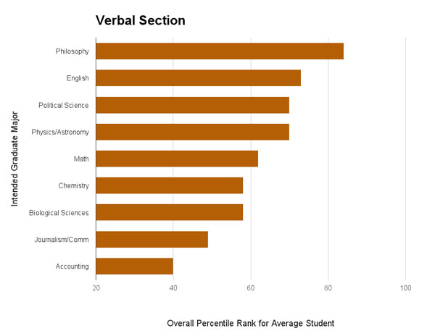
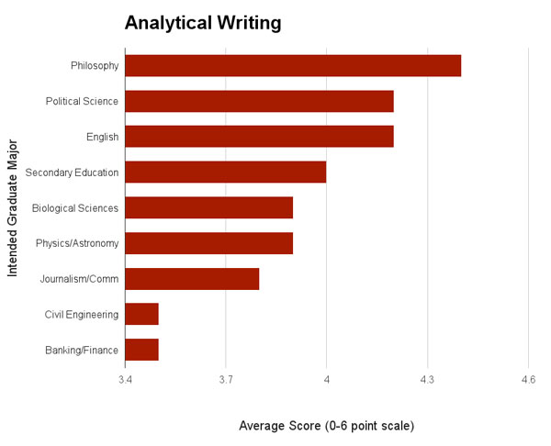
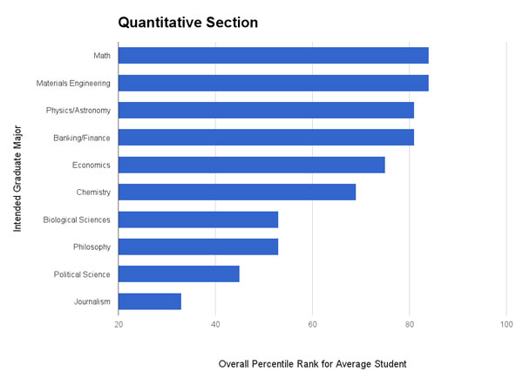
GRE Scores by intended graduate major
The verbal section requires students to fill in the blank for sentences and answer comprehension questions about short passages, among other problems.
The analytical writing section requires two essays: an analysis of a flawed argument and a more general position paper on an issue.
The quantitative reasoning section measures mathematical ability and data interpretation skills. The score scale ranges from 130-170. Data from ETS (PDF) for August 2011-April 2012.

Slide 15
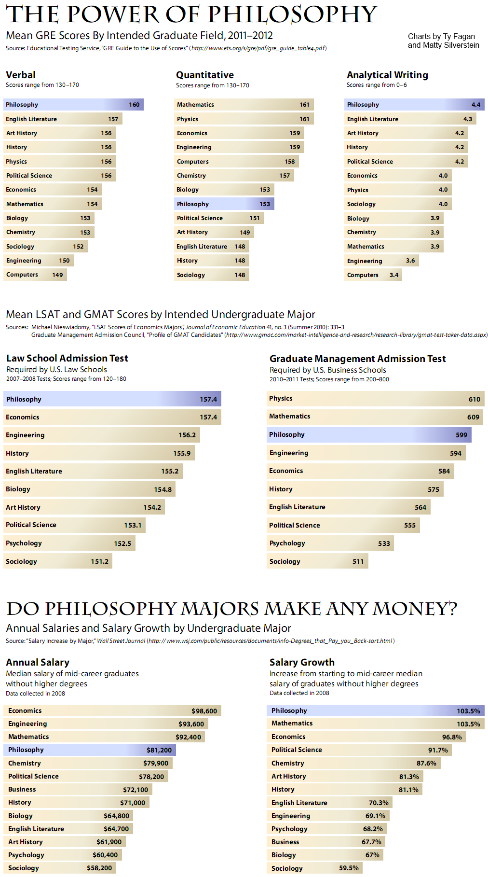
Philosophy is Powerful
The Power of Philosophy - APA

Slide 16
Philosophy pays…
Major | Median Mid-Career Salary
Economics | $98,600
Computer Science | $95,500
Finance | $88,300
Information Systems | $82,300
Philosophy | $81,200
Political Science | $78,200
Business Management | $72,100
Communications | $70,000
Nursing | $67,000
Biology | $64,800
Psychology | $60,400
Criminal Justice | $56,300
Nutrition | $55,300
Music | $55,000
Education | $52,000
Data collected from the Wall Street Journal.
And the study of philosophy is excellent preparation for entry into law school (LSAT), graduate school (GRE), business school (GMAT)

Slide 17
Philosophy and Critical Thinking
Critical Thinking is a required course for transfer to the CSUs.
Philosophy as a discipline introduced and developed critical thinking over the past 2,500 years.
We offer many sections of critical thinking. A full time growth hire will allow us to offer more critical thinking courses.
1,236 students are earning an AA degree in General Studies. Philosophy courses, and critical thinking, are crucial to this degree.

Slide 18
The study of philosophy directly facilitate MJC Program Learning Outcomes
Demonstrate proficiency in LANGUAGE AND RATIONALITY:
Demonstrating awareness of the interactive nature of communication involving effective listening, reading, writing, and speaking.
Demonstrating critical thinking in the analysis and production of communication.
Demonstrating the ability to find, evaluate, and use information in a variety of formats.

Slide 19
Curriculum, SLO Assessments, Program Review
We are on schedule with curriculum compliance, SLO assessments and program review
Two additional hires will provide the resources to maximize and implement best-practices in SLO assessment and curriculum development. We are straining now to maintain these.

Slide 20
Demonstrate proficiency in HUMANITIES:
Demonstrating awareness of the various ways that culture and ethnicity affect individual experience and society as a whole.
Demonstrating the ability to make well considered aesthetic judgments.
Demonstrate proficiency in NATURAL SCIENCE:
Explaining how the scientific method is used to solve problems.
Describing how scientific discoveries and theories affect human activities.
Demonstrate proficiency in SOCIAL AND BEHAVIORAL SCIENCE:
Describing how societies and social subgroups have operated in various times and cultures.
Analyzing the ways that individuals act and have acted in response to their societies.

Slide 21
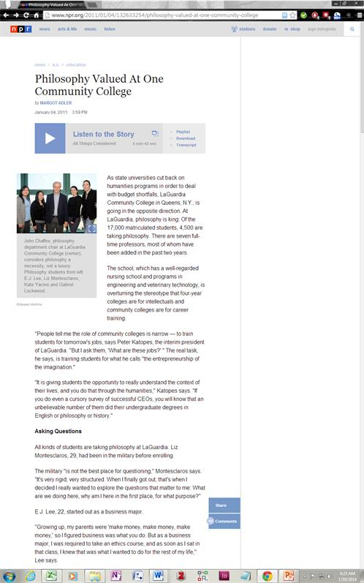
” As state universities cut back on humanities programs in order to deal with budget shortfalls, LaGuardia Community College in Queens, N.Y., is going in the opposite direction. At LaGuardia, philosophy is king: Of the 17,000 matriculated students, 4,500 are taking philosophy.”

Slide 22
Restoration of our 2012 and 2015 positions will result in continued growth and student success
We have a large program.
Two full time growth/restorative hires permit more student-faculty connection and thus improved student success.
Two full time growth/restorative hires will result in a more robust philosophy curriculum and allows for increased emphasis on developing program support for students such as tutoring.
A full time growth/restorative hire reduces the likelihood of future shrinkage of our program.

