Slide 1
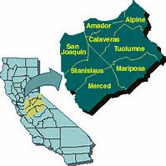
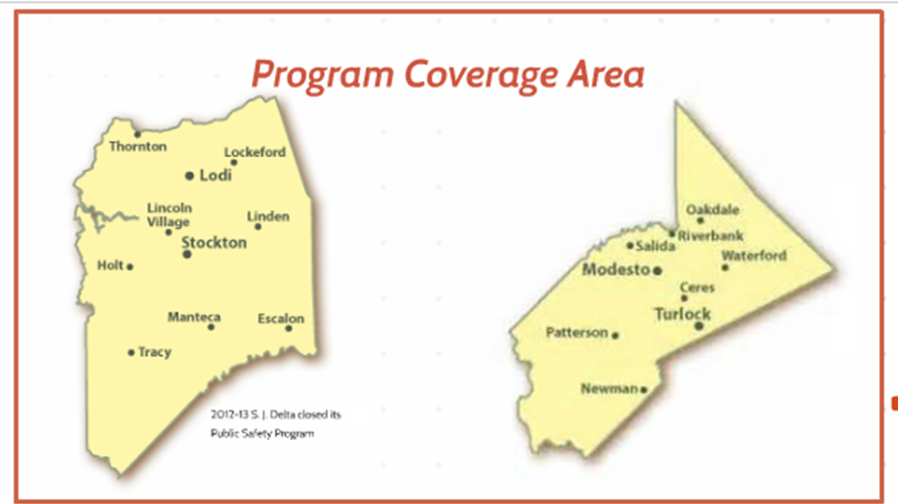
CTE – Instructor of EMS
Pedro Mendez
Ron Cripe
November 4, 2016

Slide 2
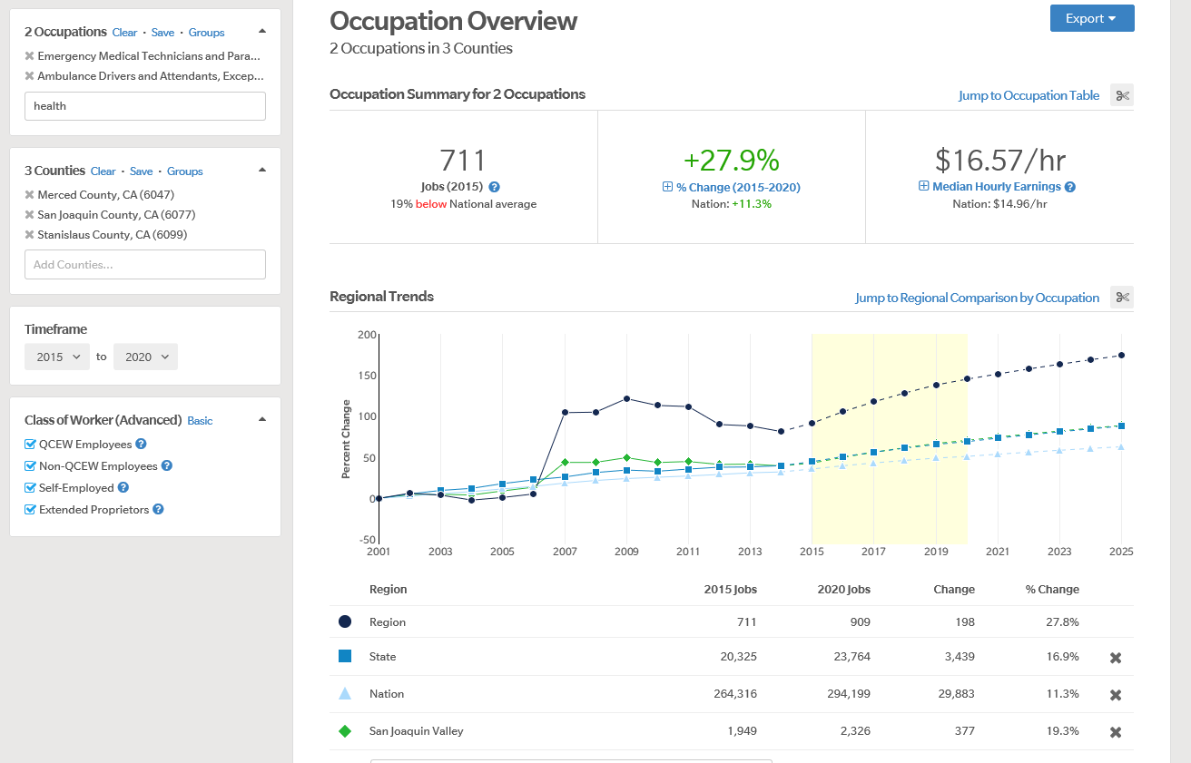
RFTC: EMS Program Market

Slide 3
EMS Program Enrollment

Slide 4
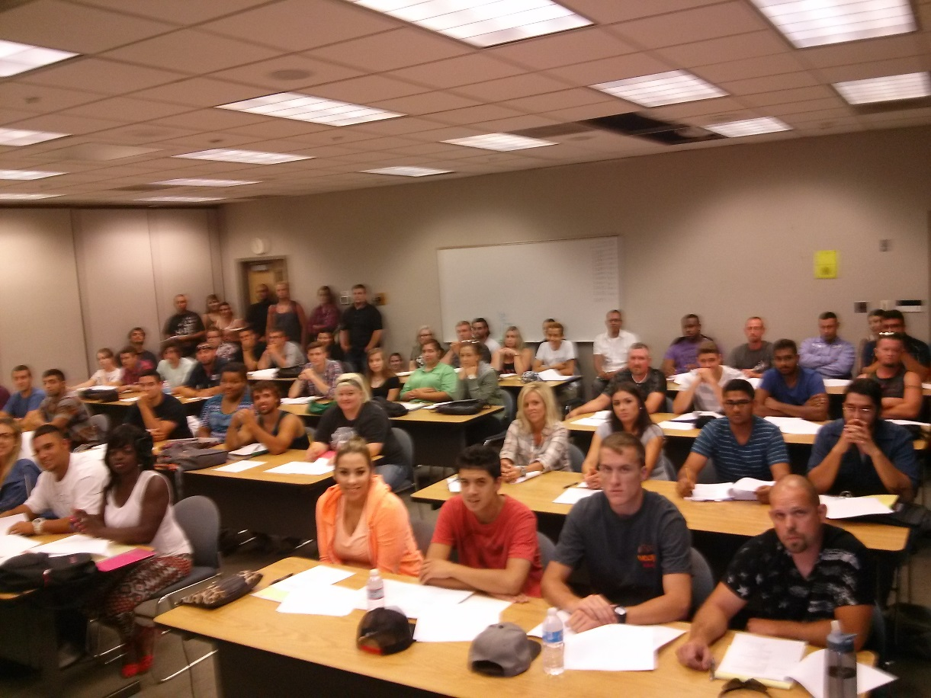
RFTC: Emergency Medical Services
Our Challenge:
EMS classes are heavily impacted. Typical 1st week of Class 50-60 students
Presently no Full Time EMS or FSCI Instructors at the Regional Fire Training Center
No College Accredited Paramedic Training Program in local region to respond to local workforce need.
Need for a FT EMS Instructor

Slide 5
EMS FTE Faculty Assignment
Value of EMS Growth Hire
Support immediate EMS Growth Need
Lead New Paramedic Program (45-59 new FTES annually)
EMS and Paramedic Program Faculty Leadership & Stewardship
Develop Career Pathways with High Schools
Assure College and CA Licensing Compliance
FT Faculty = Higher Student Success
Support Strong Workforce Taskforce and WIOA recommendations to respond to Workforce needs.

