Slide 1
CVC-OEI Course Design Rubric Crosswalk
December 2016 version compared with October 2018 version.

Slide 2
CVC-OEI Course Design Rubric
We are excited to roll out the October 2018 version of the CVC-OEI Course Design Rubric to all of you.
The Course Design Rubric was developed in 2014 by the OEI Professional Development Workgroup. In addition to preparing courses for the CVC Exchange, the rubric is used by campuses, Distance Education Programs, and individuals across all California Community Colleges as a tool for course design, course quality review, and professional development.

Slide 3
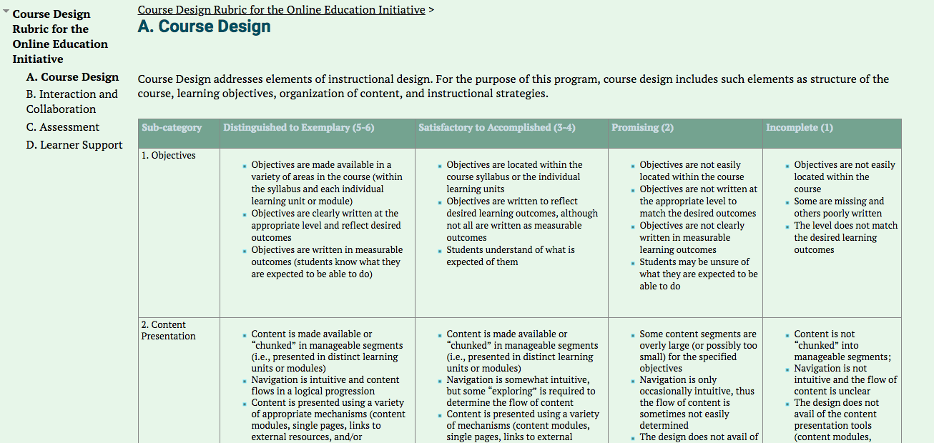
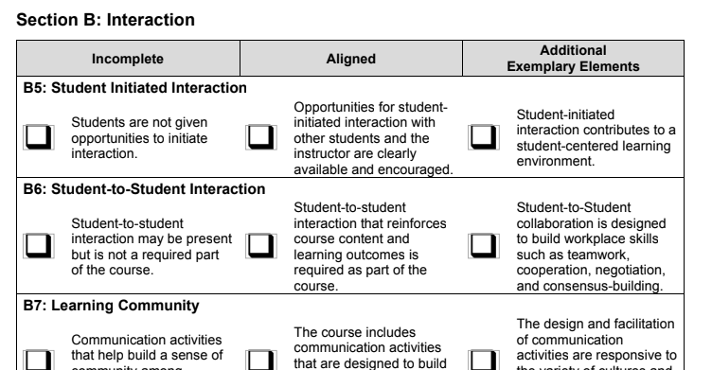
The Rubric previously went through three major revisions in response to changes in instructional technology, regulatory updates, and feedback from users.
The most recent set of updates do not represent major changes, but were needed to …

Slide 4
Overview of Changes
… Eliminate redundancies where multiple elements referred to the same issue.
Update language in Section B to more closely align to Title 5.
Add counseling, readiness, and tutoring to Student Services that are needed for equitable student access.
Add more explanatory text and examples for users to avoid confusion.
Make corrections to punctuation and grammar.
Streamline and improve the accessibility section.
Make it easier for colleges and individuals to adopt and use.

Slide 5
About the Crosswalk
This crosswalk of the differences between the last version (released in December 2016) and the latest updates (released in October 2018) is not a detailed list of every word or punctuation change. It is meant to bring attention to the significant changes that may affect how the rubric is used.
The rubric can be found online at onlinenetworkofeducators.org or at cvc.edu

Slide 6
Review Information Page: We removed “P2” since a second Peer Reviewer is not always used in a review process; replaced jargon (P1, ACE) with clearer labels (Peer, Accessibility).
Previous
New

Slide 7
Table of Sections: The new table reflects the fact that some elements were rearranged, allowing us to “chunk” related elements into meaningful groups.
Previous
New

Slide 8
Unit Objectives: These elements were edited to focus on “learning units” and the reference to “modules” removed since it created some confusion. The reference to “assessments” in Section A was removed since it was redundant with Section C. The need for there to be sufficient content to meet objectives was added to A3.
Previous
New

Slide 9
Use of CMS: A7 and A8 were grouped with A4-A6 since they all review how the CMS is used to aid learning. The name of A8 and some wording was changed to more accurately reflect what is being reviewed (use of multimedia) in that element.
Previous
New

Slide 10
Learner Support: A11 was grouped with A9-A10; examples were provide for A9 Incomplete to aid reviewers. The name of A10 was changed to better reflect the intent of that element.
Previous
New

Slide 11
Institutional Support: A12-A14 were grouped together. A12 was more accurately renamed, and examples of student services were changed to include online tutoring, online counseling, and online readiness. Technology support criteria was broadened beyond the instructor role.
Previous
New

Slide 12
Section B: This section was divided into “Instructor Contact” and “Student-to-Student Contact.” Most elements were reworded to better reflect Title 5 and to give more guidance to reviewers. The word “plan” was taken out of B2 to give instructors more options for demonstrating regular effective contact throughout the course.
Previous
New

Slide 13
Student-to-Student Contact: Regular effective contact among students was more clearly defined to reflect Title 5 and the findings in the 2017 Distance Education Report that describe the connection between a sense of community and student success in online learning.
Previous
New

Slide 14
Accessibility: Elements from Section E were moved to the beginning of the Accessibility Section and more guidance (including links to resources) was added for both instructors and colleges using the rubric. The role of the instructor and the institution for ensuring accessibility of courses is more clearly described.

Slide 15
Section D: Previously, this section was divided between Content Pages and Files. In the new version, elements such as headings, lists, and links that can be found in both places were combined, reducing the length of this section from eight pages to just over four.
Previous
New

Slide 16
More descriptive language was added to some elements to better explain how students with disabilities may be affected. Guidance was added to show where to check for accessibility.
Previous
New

Slide 17
Questions?
If you have questions about the rubric, the changes, or about adopting it locally on your campus, please feel contact a member of our team:
Stacey Carrasco, Senior Program Coordinator scarrasco@cvc.edu
Lené Whitley-Putz, Faculty Mentor for Instructional Development lwhitleyputz@cvc.edu
Autumn Bell, Director of Professional Development abell@cvc.edu

