Slide 1
Student Services Peggy Fikse – Director Student Financial Services On Both Campuses we serve: Admissions and Records; Financial Aid and Assessment East -- Student Service Building West -- Yosemite Hall – first floor

Slide 2
START DATES
FAFSA
Free Application for Federal Student Aid
www.fafsa.gov
Apply October 1st
CADAA The California Dream Act Application
https://dream.csac.ca.gov/
Please encourage students to apply!

Slide 3
Financial Aid Overview
Type of Awards:
Fee Waivers 80 % of MJC students receive the Fee Waiver
Board of Governors Fee Waiver – Now
California College Promise Grant – CCPG /Waives Tuition ONLY
For students enrolled 12 units and first time at MJC
Other State Grants-
Cal Grant
Cal Grant B maximum award $ $1,672 Full-time
Cal Grant C maximum award $ 1,094
FTSSG - Enrolled in 12 units plus & receiving Cal Grant
CCCG – Calif College Completion Grant - $1,500 Academic Year

Slide 4
Focus Groups
Foster Youth - Chafee Grant
Dreamers – 1 Time Emergency fund
Homeless – Priority Fee Waiver if documented homelessness
Dependency Overrides

Slide 5
Federal Funds Federal Pell Need based & refund based on unit load at time of disbursement 17 – 18 $ 5,920 18 – 19 $5,950 Unit Load: 12 + = Full Time 11.5 – 9 = Three-quarter time 8.5 – 6 = Half- time 5.5 - .50 = Less than ½ time Additional Aid: Federal Work Study – must turn in pay claim = hours worked SEOG = Supplemental Educational Opportunity Grant $1,000

Slide 6
Return to Title IV (R2T4) A student who receives federal financial assistance and withdraws from all of their classes before completing more than 60% of the semester will be required to return any unearned federal funds. Have students check with financial aid before dropping classes May owe funding back and/or May no longer meet Satisfactory Academic Progress The college could be liable in paying the students debt. To lower what the college owes: Keep an attendance roster Drop students from roster right away Do not wait until census to drop students from the course Last day of ATTENDANCE is important to our reporting – please post LOA PLEASE DROP STUDENTS BEFORE THE REFUND DATE IF APPLICABLE Questions regarding R2T4 / overpayments = Kristina Godinez ext. 575-7702

Slide 7
Notes on Student Attendance:
Students are funded / when eligible for repeated courses that they fail – No Limit
For Federal eligibility a “D” grade is passing and once a student passes a course they are not eligible for funding for that course again.

Slide 8
Student Academic Progress (SAP)
Qualitative Requirements:
All financial aid students are required to maintain a minimum cumulative GPA of at least 2.0.
Quantitative Requirements:
Maximum time frame: Financial aid students are expected to complete their program of student with 150% of the published length of the program. 90 attempted units
Pace of progression: Financial aid students are expected to have completed at least 67% of all units attempted.
Lifetime Eligibility Used (LEU)
Federal law limits the amount of Federal Pell Grant Funds a student may receive over your lifetime which is equivalent to six years of full Pell Grant Funding. 600%
Students can view their own LEU by using the following:
https://www.nslds.ed.gov/nslds_SA/

Slide 9
Approved – fund a semester then re-review
Denied - must meet standards

Slide 10
New This Year
Bog Name change – CCPG = Calif College Promise Grant
Calif College Completion Grant

Slide 11
California Promise = AB 19
First time to college
Full Time enrollment
1 full year of tuition waved
But …… requires MJC to offer student loans

Slide 12
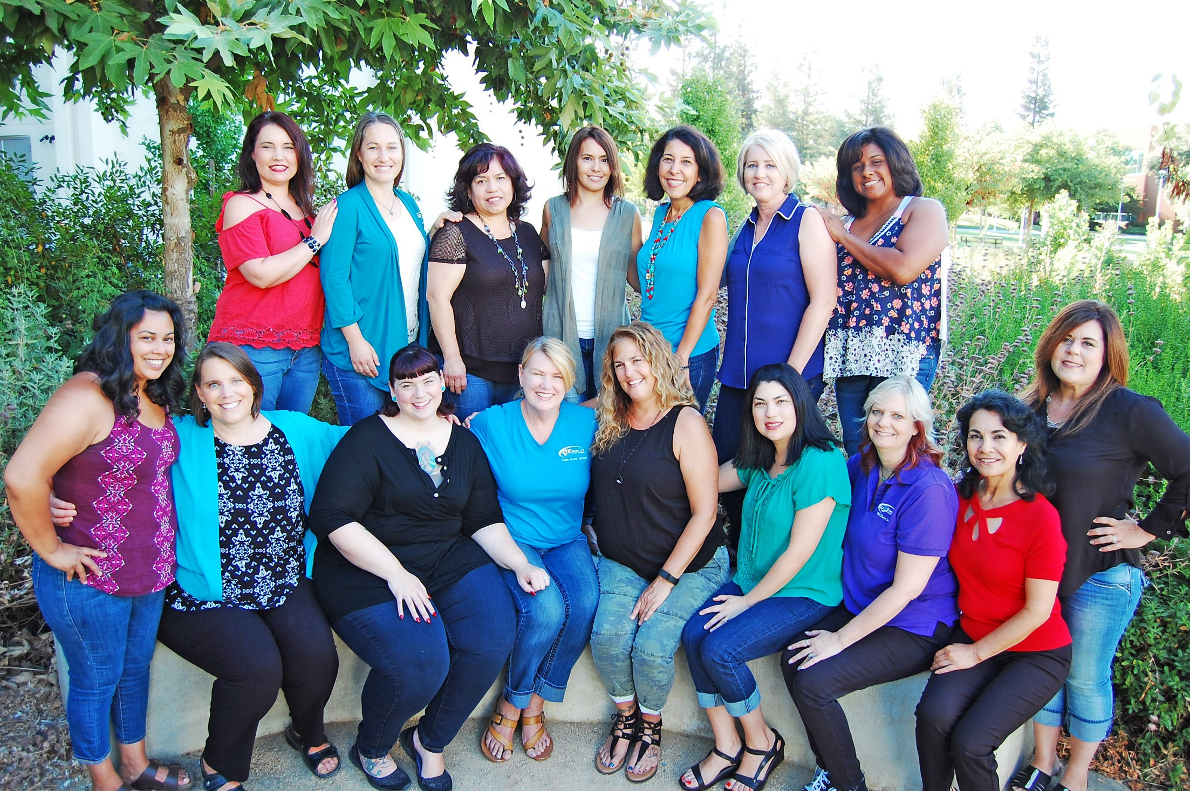

Slide 13
Questions

