Slide 1


Guided Pathways
at California Community Colleges
Notes:
OK

Slide 2

About Guided Pathways
The Guided Pathways framework creates a highly structured approach to student success that:
Provides all students
with a set of clear course-taking patterns that
promotes better enrollment decisions and prepares students for future success.
Integrates support services in ways that make it easier for students to get the help they need during every step of their community college experience.

Slide 3

Four Pillars of Guided Pathways
Create clear
curricular
pathways to
employment
and further
education.
Help students
choose and
enter their
pathway.
Help students
stay on
their path.
Ensure that
learning is
happening
with
intentional
outcomes.

Slide 4

Key Elements of Guided Pathways
Programs that are fully
mapped out and aligned with
further education and career advancement while also providing structured or guided exploration
for undecided students.
Redesigning and integrating basic skills/developmental
education classes to accelerate students to college-level classes.
Proactive academic
and career advising
from the start through
completion and/or transfer,
with assigned point of
contact at each stage.
Structured onboarding process
including improved placement tests
and co-requisite instruction that provide students with clear, actionable, and usable information they need to
get to the right start in college.
Early alert systems
aligned with interventions
and resources to help
students stay on the pathway,
persist, and progress.
Instructional support and
co-curricular activities
aligned with classroom learning
and career interests.

Slide 5
What Guided Pathways Means for Students
Less confusion and more clarity about the steps toward completion and course-taking behavior.
More guidance from counseling or advisory early in students’ journeys.
Greater likelihood of completion, as a result of:
  Improved placement
  Basic skills/developmental education reform
  Reduced unit accumulation
Improved chances for transfer and career placement.

Slide 6
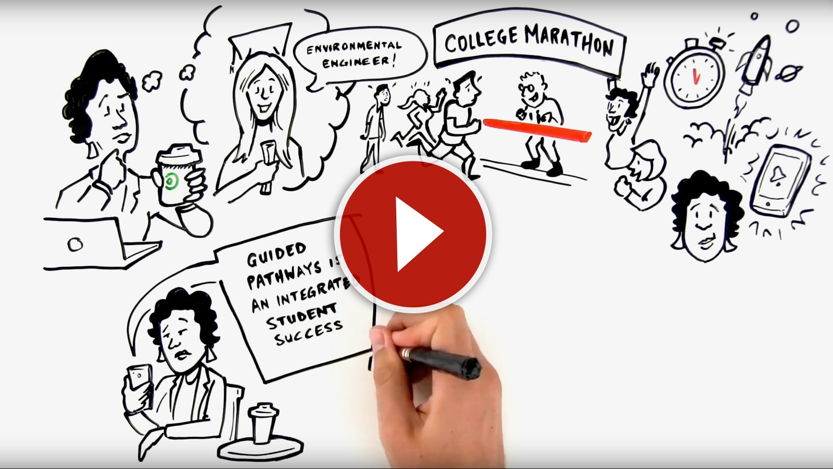
What Guided Pathways Means for Students
Notes:
When in slideshow mode, click on image to launch video.
Direct link to video is: https://m.youtube.com/watch?v=tGEV6IoizGQ

Slide 7
What’s Different About Guided Pathways?
Guided Pathways represents a comprehensive approach to improving student completion
Focuses on institutional transformation
Provides an overarching framework to integrate diverse initiatives & reforms underway
Brings together evidence-based practices into a more coherent whole
Emphasizes interventions that work at scale
Creates clear, intention, well-sequenced curriculum and program design
Keeps students at the center of the (re)design process
Is an evidence-based approach that comprehensively addresses the conditions needed for students to thrive and complete their goals

Slide 8
Ways Colleges Have
Implemented Guided Pathways
Ensure access to college-level classes
  Place students accurately (via multiple measures)
  Engage students with curricular enhancement such as acceleration and co-requisites
  Allow students to enroll in college-level curricula with supports as an alternative to placement in developmental English & math
Ensure students can access the classes, programs, and support they need
  Planning enough sections to avoid wait-listing students
  Accessible & consistent counseling help and advice
  Student tracking systems to follow students on the path

Slide 9
Ways Colleges Have
Implemented Guided Pathways
Create opportunities for students to explore their options without using all their financial aid
  Introductory courses that count for multiple majors
  Clusters or disciplines that students can choose before
  narrowing down their field of study
  Clear sequences of courses built toward students’ chosen
  certificate or degree
  The right classes at the right times
Guide students to make choices that lead to completion & success
  Clear and strategic educational plans
  Majors in clusters
  Peer-to-peer connections

Slide 10

Support is Available for Implementation
In 2017, California leaders allocated $150 million from Prop. 98 funds for awards to community colleges to develop Guided Pathway Frameworks to support students.
All 114 California Community Colleges are eligible to receive award funding.

Slide 11
Guided Pathways Depends on US.
Guided Pathways is not a “one-size-fits-all” initiative…
The enormity and diversity of the California Community Colleges system requires that each college take a customized, self-guided approach.
Guided Pathways is an opportunity for our college to set our own goals and determine our best path to success.

Slide 12

Steps to Becoming a “Pathways College”
1. SELF-ASSESSMENT
We will complete a self- assessment for Guided Pathways implementation.
The completion of this process will require college-wide efforts and cross-functional collaboration.
The Chancellor’s Office will provide regional workshops to support the self-assessment and planning process.

Slide 13

Steps to Becoming a “Pathways College”
2. ALLOCATIONS
Beginning in Feb 2018, the Chancellor’s Office will release the first installment of funding.
Funds will be released upon completion of milestones: the assessment tool, the multi year plan and college staff attendance at trainings.
The Chancellor’s Office will provide regional workshops, capacity-building and on-site support, resources and tools.

Slide 14

How Can Our College Be Involved
with Guided Pathways?
IN THE EARLY STAGES…
Guided Pathways requires a coordinated cross-departmental and divisional effort from college staff, faculty and leadership to share, engage, and discuss.
Think and talk about the unique planning and resource needs at OUR college.
Participate in the self-assessment process.

Slide 15

How Can I Support Guided Pathways?
AFTER KICKOFF…
Be a Champion for Guided Pathways. Spread the word, share successes, and encourage others to get on board.
Attend regional meetings, network with other colleges, and take advantage of available educational tools and professional learning offered through the CCCCO.
Celebrate success and pay it forward by sharing data, resources and advice with other colleges.

Slide 16
For More Information
Visit
iepi.cccco.edu/guided-pathways
or email COGuidedPathways@cccco.edu

