Slide 1
Physical, Recreation, and Health Education Division
Two Growth Positions Requested

Slide 2
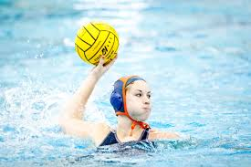
Rationale for Hiring Instructor of Physical Education, Women’s Water Polo & Swimming
FALL 2015

Slide 3
Growth? Replacement? Replacement.
This position is designated as “Growth” because of a professor’s transfer between divisions.
In August of 2015, the Professor and Head Coach of Women’s Water Polo and Women’s Swimming transferred to another division.
The result is a loss of full-time faculty in Physical, Recreation, and Health Education.
The temporary solution is to have one Head Coach for Men’s and Women’s Water Polo and Men’s and Women’s Swimming.
That’s four teams led by one coach.
In addition to that faculty member’s other teaching load and professional responsibilities…too much.
PE/Women’s Polo & Swimming

Slide 4
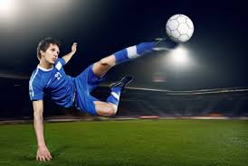
Rationale for Hiring Instructor of Physical Education, Head Coach Men’s Soccer
FALL 2015

Slide 5
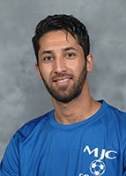
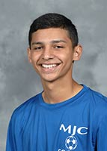
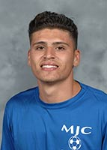
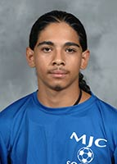
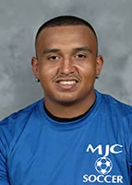
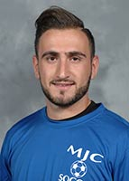
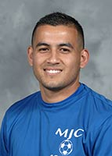
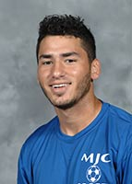
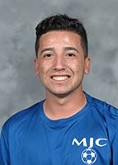
An HSI Serving Hispanic Students
The Head Coach of Men’s Soccer has always been a part-time faculty position at MJC.
70 men try-out, 29 are on the team this year
Raising the academic performance of Men’s Soccer boosts college’s equity indicators
Reported by the coach and counselor, the Men’s Soccer team GPA is lower than college averages and the lowest of all sports teams

Slide 6
What is a coach?
At MJC, all coaches are faculty.
20 hour loads, 350 contact hours per semester
The same load as Allied Health, Ag, Tech Ed, and EMS
FTES:FTEF reaching 936:46 in PE and 450:25 in Health (13-14 & 14-15)
“Practice” is FTES-generating instruction
All practices are classes in PiratesNet and generate FTES
In-season varsity classes are 3 units
Out-of-season varsity training and conditioning classes are variable unit: ½ to 3
All student-athletes must be full-time students
This means that all 397 student-athletes are taking at least 12 units every semester
That’s a minimum of 4,764 units of FTES-generating enrollment from student-athletes alone.
Women’s Polo & Swimming  Men’s Soccer

Slide 7
Student Success & Equity
“MJC’s Student Equity Plan outcomes show disproportionate impact for students of color and other special populations” (Enrollment Management Brief).
Student-athletes exceed college success and retention rates in every disaggregated area.
Student-athletes exceed college success and retention rates
in every disaggregated area.
Women’s Polo & Swimming  Men’s Soccer

Slide 8
Defeating Academic Disproportionate Impact
Women’s Polo & Swimming  Men’s Soccer

Slide 9
Athletics as Student Equity
“MJC is committed to access, completion, and excellent education for all students…. Particular groups are targeted for these areas based on equity indicators…. Current data identified these groups:” (Student Equity Plan 2014-2017)
Women’s Polo & Swimming  Men’s Soccer

Slide 10
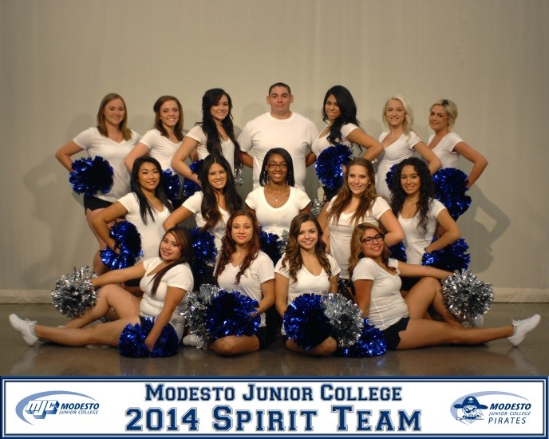
Thank you!
Photographer David Todd
Content contributors Tina Giron, Eric Fischer, Milan Motroni, Steve Aristotelous, and Nick Stavrianoudakis

