Slide 2
History

Slide 3
Mechanized Agriculture
Two traditional programs within Mechanized Agriculture
Power Equipment (Todd Conrado)
Welding Fabrication (Steve Amador)
Irrigation Technology Program was added in Fall 2015
(Steve Amador)

Slide 4
Mechanized Agriculture Current Offerings
2 - Full Time Teaching Faculty
9 Sections Taught by Adjunct Instructors
Offering 26 to 28 sections / year
Consistent fill rates at or near 100%
(fall 2014 is 98.5%full)
Limited by staff available to teach courses

Slide 5
AGRICULTURE & ENVIRONMENTAL SCIENCES MECHANIZED AGRICULTURE
2005 2010 2015
FALL
Enrollment 120 318 244
FTES 12.24 46.22 39.31
FTES/FTEF 5.97 13.80 12.68
WSCH/FTES 179.12 413.94 380.40
Regular 2.00 2.00 1.75 Adjunct 0.00 0.75 1.00 Overload 0.05 0.60 0.35

Slide 6
AGRICULTURE & ENVIRONMENTAL SCIENCES MECHANIZED AGRICULTURE
2006 2011 2016
SPRING
Enrollment 129 243 209
FTES 17.61 40.81 36.51
FTES/FTEF 6.37 12.96 11.23
WSCH/FTES 191.22 388.66 336.97
Regular 1.95 2.00 1.45 Adjunct 0.08 0.75 1.25 Overload 0.73 0.40 0.55

Slide 7
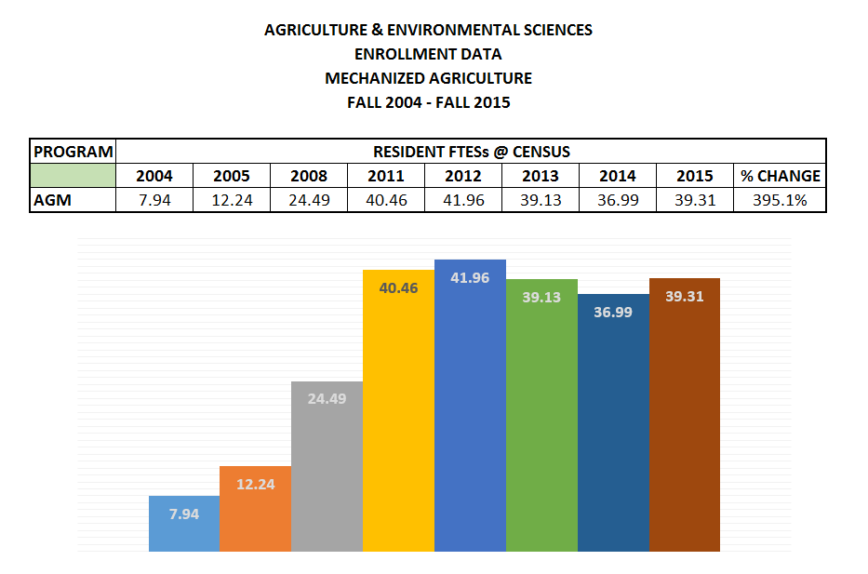
Resident Fall FTES at Census

Slide 8
Future

Slide 9
AGRICULTURE & ENVIRONMENTAL SCIENCES MECHANIZED AGRICULTURE
Growth Opportunities
National Science Foundation ATE - Agriculture Irrigation Technology Grant
$833 thousand dollar contract to the college
Currently in our second year
A new AS degree in Irrigation Technology along with 4 certificates
Currently the only irrigation AS degree in the state
In the process of applying to make MJC a national center for Irrigation technology

Slide 10
Occupational Outlook
The USDA predicts 57,900 annual job openings (for skilled workers) in agriculture, with only 35,400 trained to fill the positions.
The United States Bureau of Labor Statistics project the US job growth for the next 10 years to be 11%, across all occupations.
Specific Job Growth
Welders 8%
Heavy Equipment Operators 10%
Heavy Vehicle and Mobile Equipment Service Technicians 8%
Pipe Fitters 12%
Irrigation / Hydrology 15%
Construction 13%
Graduates of the mechanized agriculture program are easily employable

Slide 11
Thank You

